Slide 1
CUMHURİYET BOARDING SECONDARY SCHOOL
Our website link is:
http://kalecumhuriyet.meb.k12.tr/tema/index.php

Slide 2
Our school is located in the west part of Turkey,called Cumhuriyet Boarding Secondary School

Slide 3
Our city is called Denizli and we are in a small town called ‘’Kale’’

Slide 4
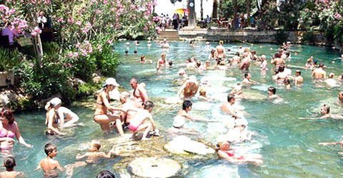
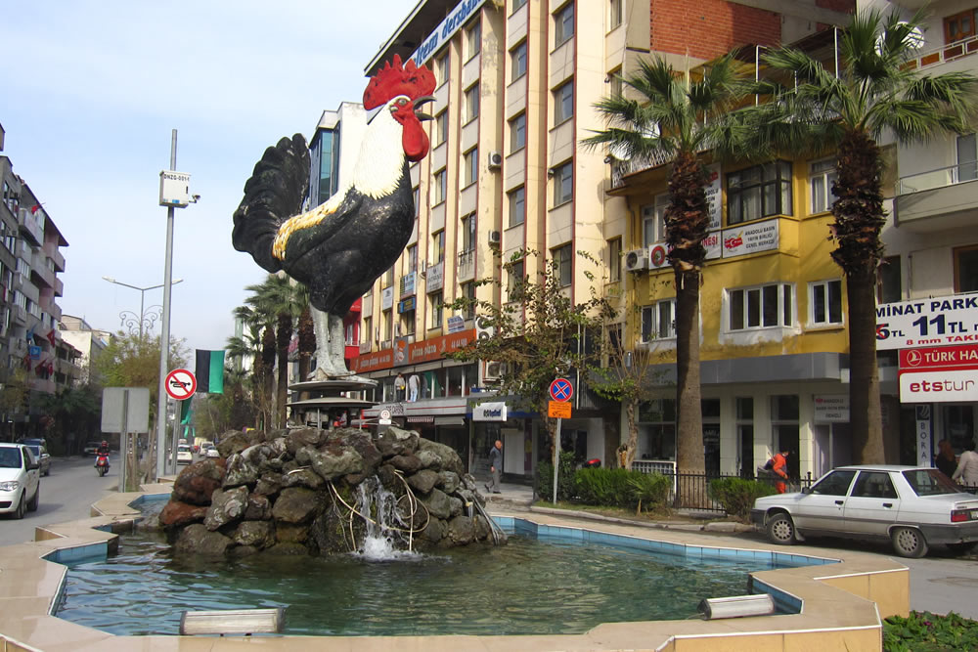
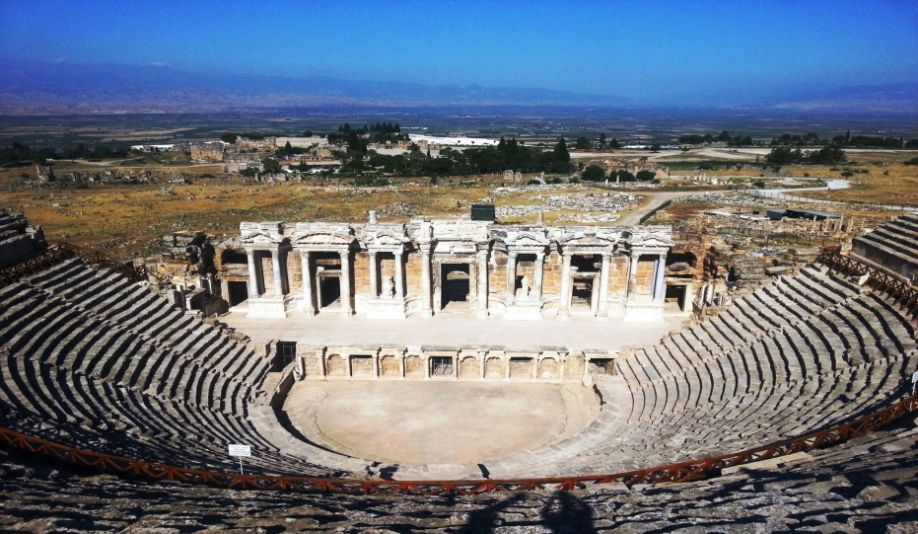
Denizli is one of the most magnificient cities of Turkey,which you should definetly visit one day in your life.It’s full of historical places.

Slide 5
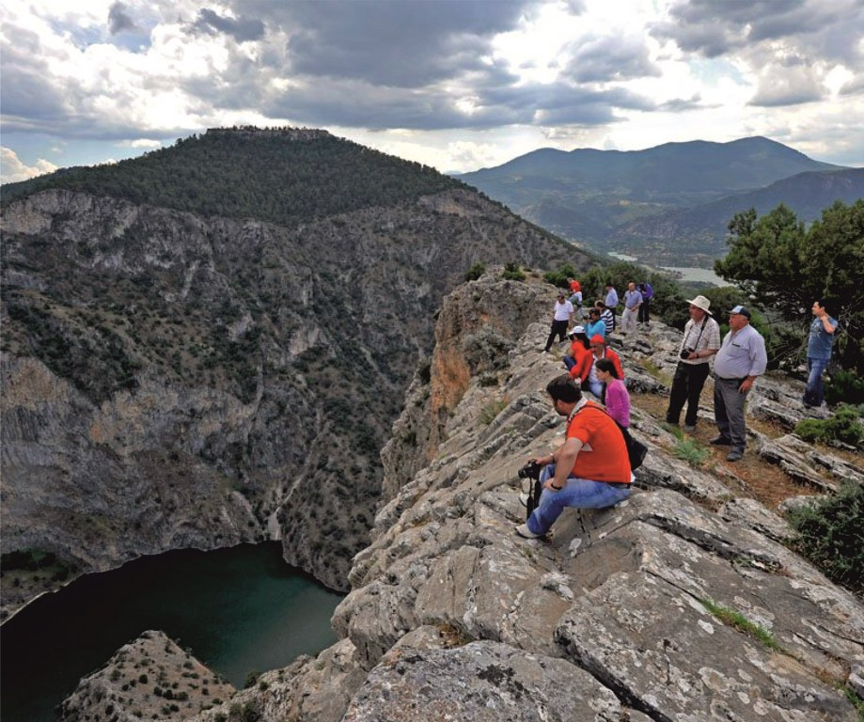
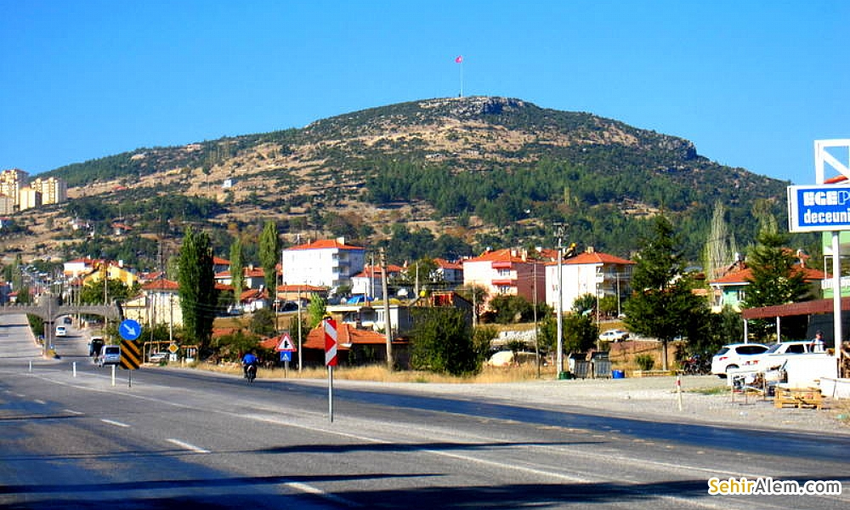
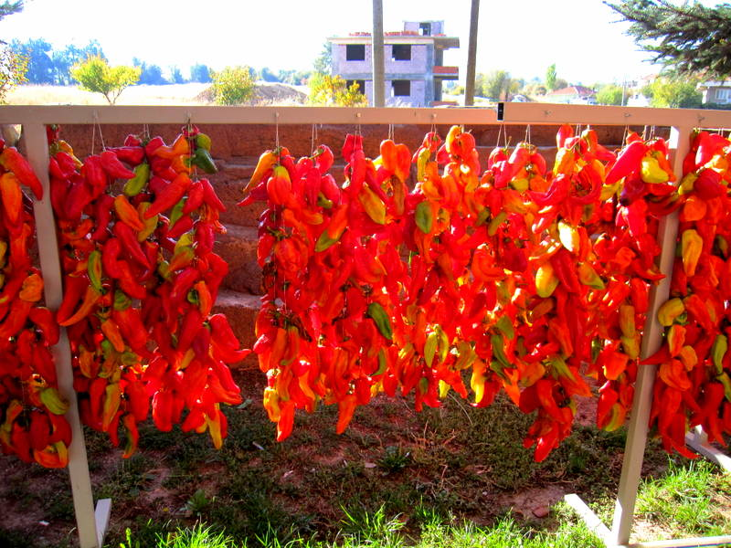
We are in Kale.Our town is very small and it has got lots of villages.We have about 250 students and they are mostly from the villages of Kale.Kale is a natural and historical town and it’s popular with red peppers.

Slide 6
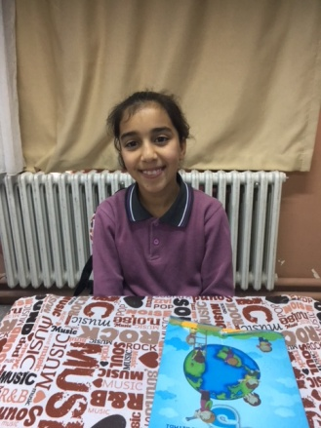
Hello.My name is Helin.I’m ten years old.My father is a butcher and my mother is a housewife.I have got three brothers and I haven’t got a sister.I like skipping a rope.My favourite colour is purple.I like Maths and English

Slide 7
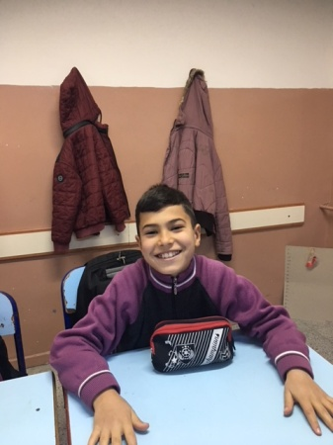
Hi.I’m Mehmet.I’m ten years old.I have two brothers and a sister.My father is a farmer and my mother is a house wife.I like swimming but I don’t like climbing.I live in Kale

Slide 8
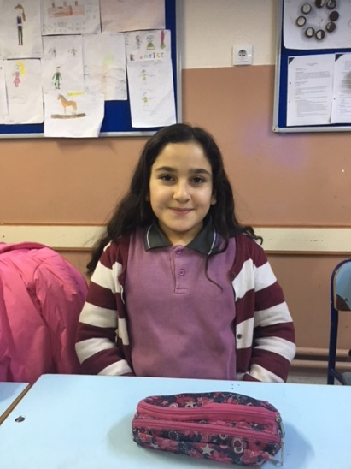
Hello.I’m Reyhan.I’m from Kale.I like Maths ,English and Science but I don’t like Music.My favourite color is red and my favourite month is April.I’m good at swimming.I love meeting new people

Slide 9
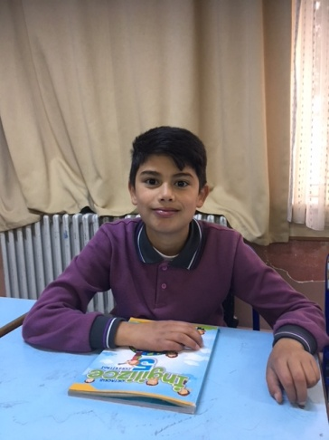
Hello.I’m Bilal.I’m eleven years old.I love motorbikes and I like riding bikes.

Slide 10
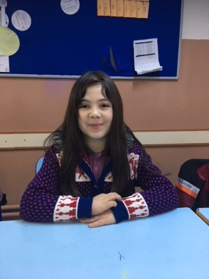
Hello!My name is Damla.I’m eleven years old.I’m from Denizli.My father is a security guard .I enjoy P.E. and English.I have got a sister

Slide 11
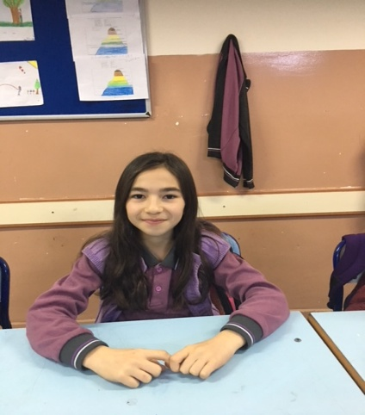
Hello.My name is Havva.I’m from Turkey.I’m nine years old.My father is a factory worker and my mother is a housewife.I like all of school subjects.I have two siblings.I like table tennis.I don’t like playing marbles.I love making a project.

Slide 12
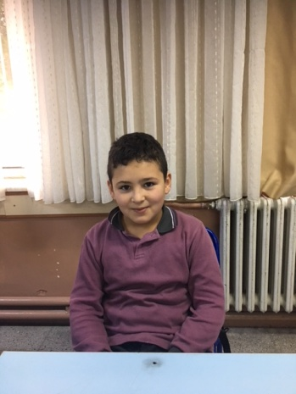
I’m Tunahan Efe.I’m from Turkey.I like English.
My mother is a housewife.I have one sister and one brother.I love riding a horse.

Slide 13
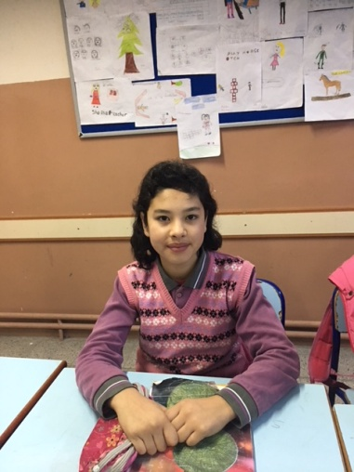
Hi.I’m Ayla.I’m at fifth grade and I’m eleven years old.I have got five sisters.I like red and white.I really like English and P.E. I like riding a horse.I’m from Turkey and I love making projects.

Slide 14
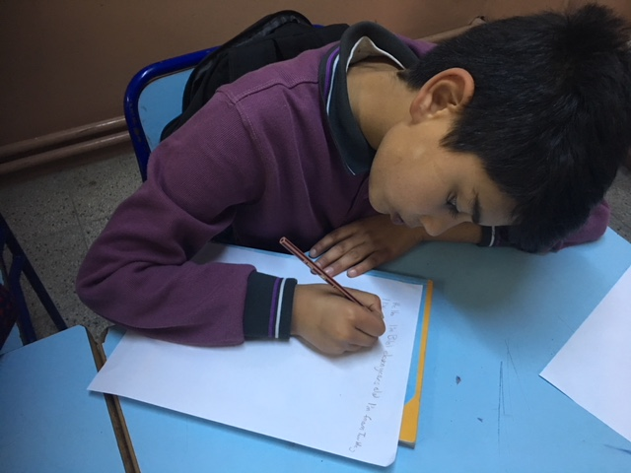
We are introducing ourselves….

Slide 15
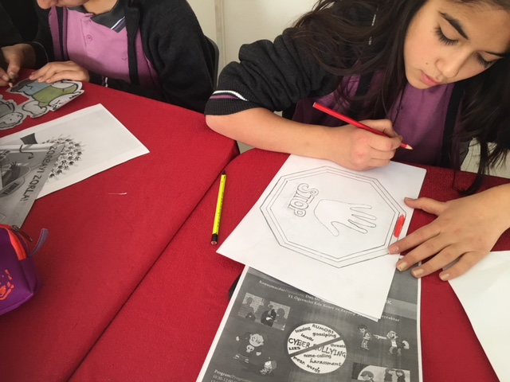
We have created a noticeboard at our school about our project topic ‘STOP BULLYING BE RESPONSIBLE’

Slide 16
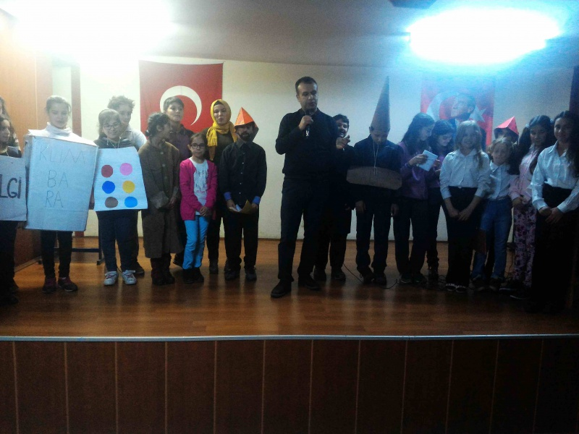
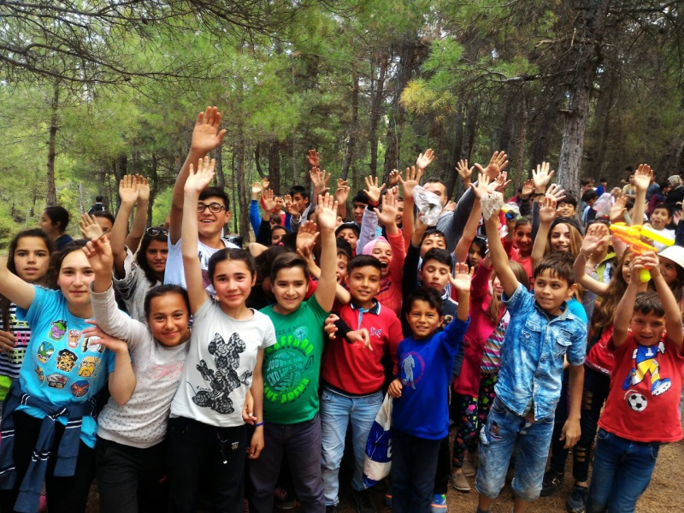
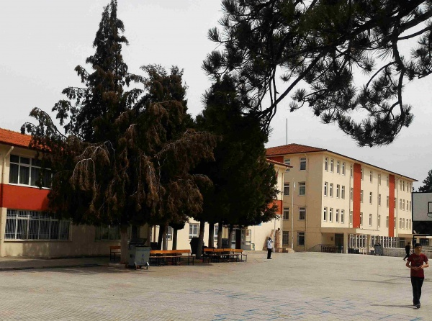
A few pictures of our school and students…

